Slide 1
Aotomated Animal Identification and Species Detection
Submitted in the partial fulfillment for the award of the degree of
BACHELOR OF ENGINEERING
IN
CSE (BDA)
Submitted by:
Sarthak Singh 20BCS4463
Utkarsh Rastogi 20BCS4474
Under the Supervision of:
Department of AIT-CSE
DISCOVER . LEARN . EMPOWER

Slide 2
Outline
Introduction to Project
Problem Formulation
Objectives of the work
Methodology used
Results and Outputs
Conclusion
Future Scope
References

Slide 3
Introduction to Project
In the vast tapestry of our planet's biodiversity, animals play an integral role. From the tiniest insects to the majestic mammals, our world is teeming with diverse species, each with its unique characteristics and importance in the ecosystem.
Today, we embark on a journey to delve deeper into the science and technologies involved in animal identification and species detection. This presentation aims to explore the methodologies, challenges, and significance of accurately identifying and classifying various animal species.

Slide 4
Introduction to Project
Importance of Animal Identification
The ability to identify and understand animal species is crucial for numerous reasons:
Conservation: Accurate species identification is fundamental to conservation efforts. It helps in preserving biodiversity and protecting endangered species.
Ecosystem Health: Understanding the different species in an ecosystem aids in maintaining its balance and health.
Research and Study: Identifying animals is essential for scientific research, behavioral studies, and ecological assessments.
Human-Wildlife Interactions: Knowing about different species helps in managing human-wildlife interactions, reducing conflicts, and promoting coexistence.

Slide 5
Introduction to Project
Methods of Animal Identification
Several methods are employed for animal identification and species detection:
Visual Identification: Recognizing animals based on physical characteristics, markings, and behaviors.
DNA Analysis: Utilizing genetic material to identify and differentiate species accurately.
Acoustic Monitoring: Using sound recordings to identify species based on their unique vocalizations.
Remote Sensing and Imaging: Employing drones, satellites, and cameras for aerial surveys and image analysis.
AI and Machine Learning: Leveraging technology to process vast amounts of data and identify species through algorithms.

Slide 6
Problem Formulation
Developing an automated system to accurately identify and classify various animal species based on visual data, such as images or videos, to aid conservation efforts, wildlife monitoring, and research initiatives.
Objective: Create an intelligent system capable of:
Accurately identifying and classifying different animal species from visual data.
Handling diverse environmental conditions, variations in animal appearance, and image quality.
Scaling to process large datasets efficiently for real-time or near-real-time application.
Providing user-friendly interfaces for researchers, conservationists, and wildlife managers.

Slide 7
Objectives of the Work
Methods of Animal Identification
Several methods are employed for animal identification and species detection:
Visual Identification: Recognizing animals based on physical characteristics, markings, and behaviors.
DNA Analysis: Utilizing genetic material to identify and differentiate species accurately.
Acoustic Monitoring: Using sound recordings to identify species based on their unique vocalizations.
Remote Sensing and Imaging: Employing drones, satellites, and cameras for aerial surveys and image analysis.
AI and Machine Learning: Leveraging technology to process vast amounts of data and identify species through algorithms.

Slide 8
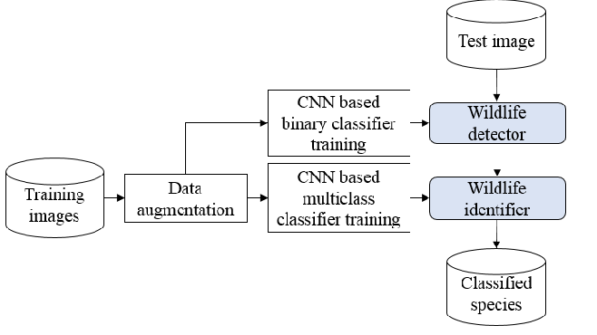
Methodology used

Slide 9
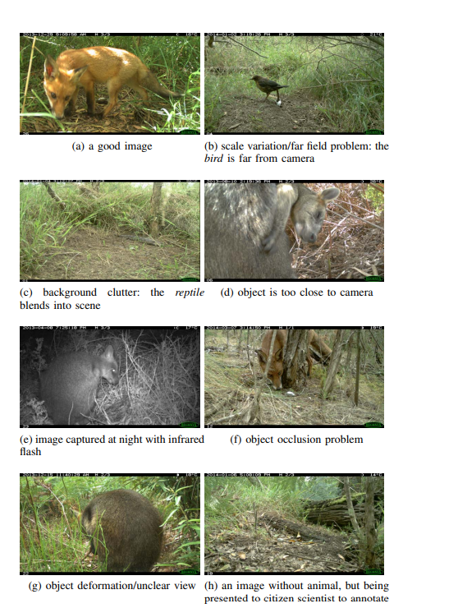
Results and Outputs
Training Results

Slide 10
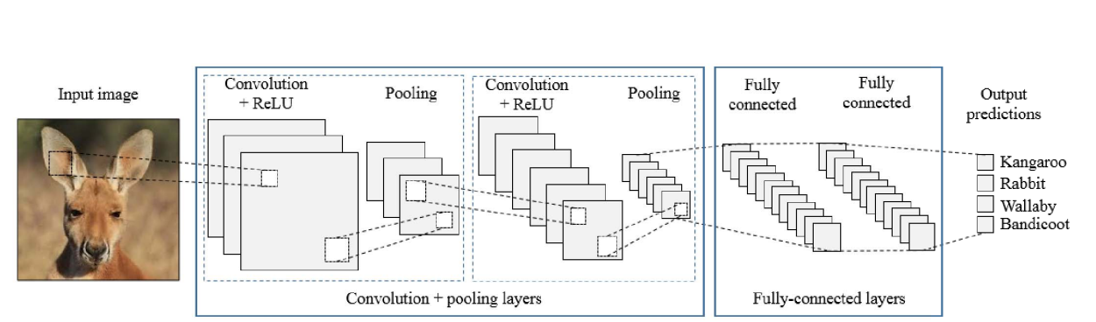
Results and Outputs
Training Results

Slide 11
Conclusion
In conclusion, understanding and accurately identifying animal species are vital for conservation, research, and maintaining the delicate balance of our ecosystems. By exploring innovative methods and addressing challenges, we move closer to a world where every species is recognized and protected. The future of animal identification holds promising developments. Advancements in technology, combined with collaborative research efforts, offer opportunities for improved accuracy and efficiency in species detection.

Slide 12
Future Scope
The future scope for automated animal identification and species detection holds significant promise across various domains, including conservation, ecology, agriculture, and animal welfare. Advancements in technology, particularly in the fields of artificial intelligence (AI), computer vision, and sensor technology, are driving innovation in this area. Here are some potential developments and applications:
1. AI-Powered Image Recognition
2. Remote Sensing and Drones
3. Camera Traps and Sensor Networks

Slide 13
References
Research Papers and Publications:
D. Lin, C. Shen, S. Taylor, et al. "Deep Learning for Automated Detection of Wildlife in Nature Images" (2016) - This paper discusses the use of deep learning for wildlife detection in images.
C. Wäldchen, M. Rzanny, P. Seeland, et al. "Automated Plant Species Identification—Trends and Future Directions" (2009) - Focuses on automated plant species identification, but discusses methodologies applicable to animal species identification.
T. Norouzzadeh, M. Nguyen, M. Kosmala, et al. "Automatically identifying, counting, and describing wild animals in camera-trap images with deep learning" (2018) - Discusses the use of deep learning for animal identification in camera-trap images.
Books:
"Computer Vision Techniques for the Automated Identification of Animals" by V. A. Robb, D. M. G. Wishart - Explores computer vision techniques specifically for identifying animals.

